Slide 1
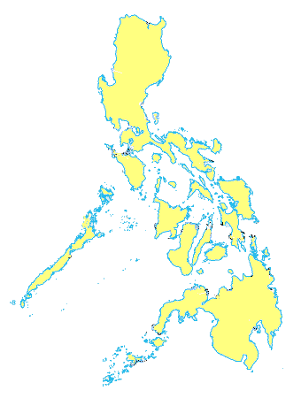
HELPING HAND
OIKOS
Oikos Helping Hand
HISTORY

Slide 2
2004 - Oikos Helping Hand started from the simple acts of sending new and used clothes and toys for distribution to the poor and needy in the Philippines.

Slide 3
2005
- Matthew 25: 35, 36 & 40 inspired O.H.H. Team Leader and was used to govern what O.H.H. would be called to do among the poor and needy in the Philippines.

Slide 4
Mattew 25:35,36 &40 35 Sapagkat ako’y nagutom at inyong pinakain, nauhaw at inyong pinainom. Ako’y isang dayuhan at inyong pinatuloy. 36 Ako’y walang maisuot at inyong pinaramtan, nagkasakit at inyong dinalaw.’
40 Sasabihin ng Hari, ‘Sinasabi ko sa inyo: nang gawin ninyo ito sa pinakahamak sa mga kapatid kong ito, ito ay sakin ninyo ginawa’.

Slide 5
- Stanley and Vida (O.H.H Singapore leaders) began to share with friends in church about their concerns for the poor in the Philippines through information gained from Vida’s sister, Maureen and her husband Ivan Ho, who are missionaries there.

Slide 6
- O.H.H started by giving small interest-free loans to help start small businesses by the poor.

Slide 7
2006 - Having seen and experienced the needs of our brothers and sisters in the Philippines, an even stronger desire to bless them stirred the O.H.H’s venture for the 2nd mission trip at the end of 2006.

Slide 8
2007 - O.H.H Inc. was registered in the Philippines. - A bold step of faith in the Lord-to embarks on a more long-term venture to bless the people in the Philippines:
a learning center for pre school children.

Slide 9
2008 - Purchased of pre school Learning Center for slum dwellers in Verdant Acres, Las Piñas city. - Additional 16 scholars sponsored back to school. - Teachers Pre-School Seminar

Slide 10
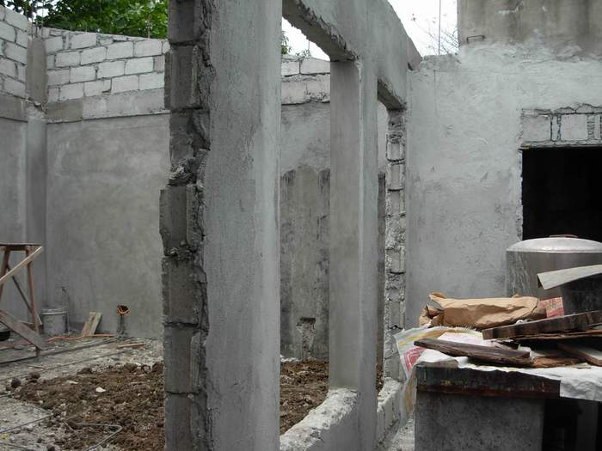
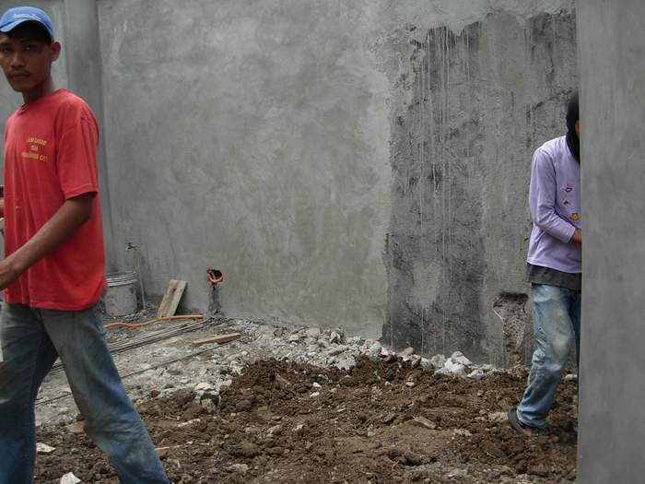
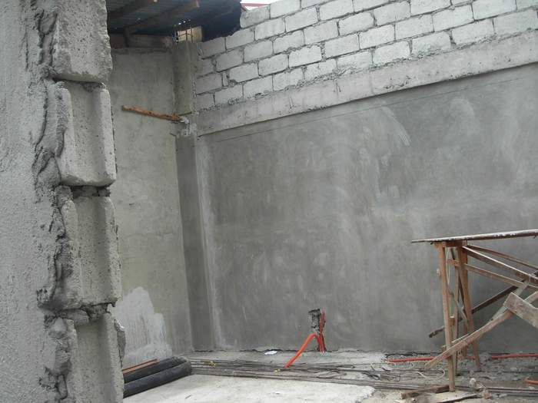
Oikos helping Hand Learning Center at Verdant Acres was under renovation

Slide 11
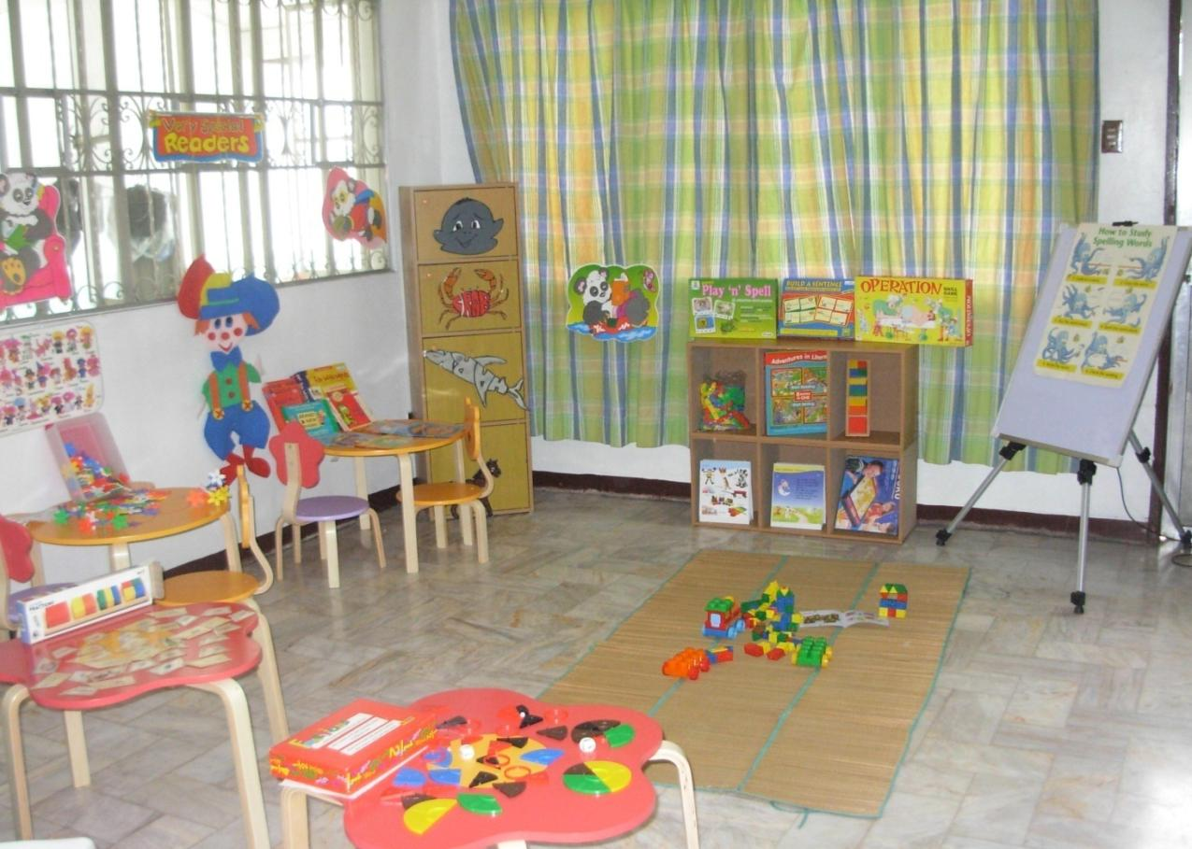
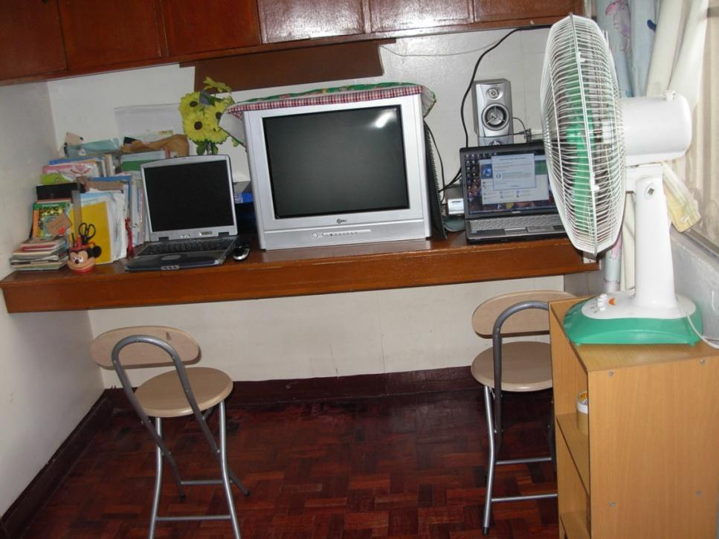
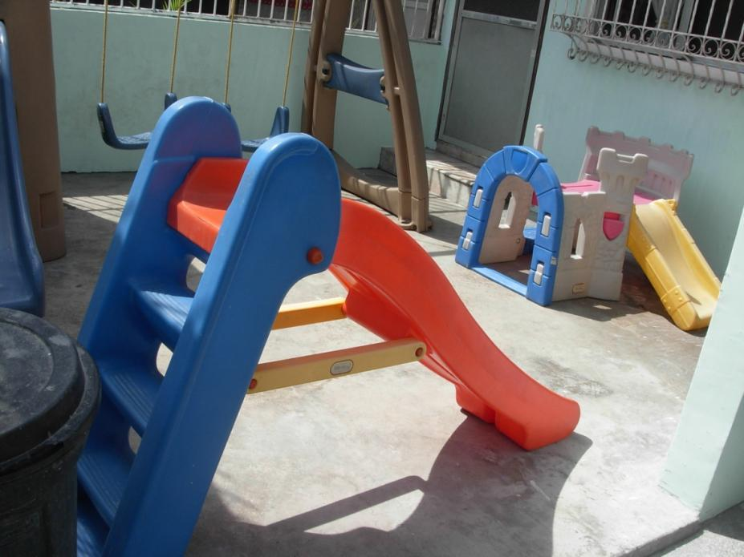

Slide 12
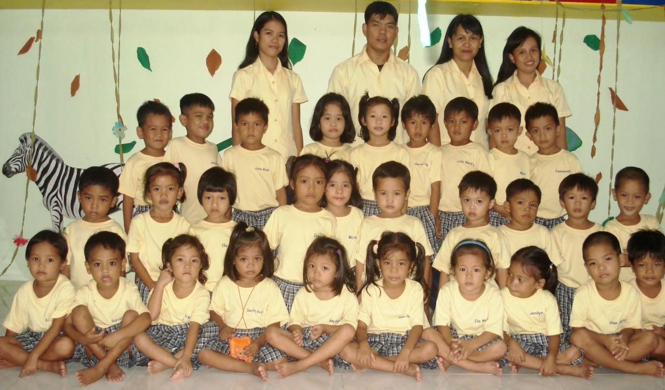
2009 - 2010 - Oikos Helping Hand Learning Center mission started for having a 30 pupils granted for a scholarship program.

Slide 13
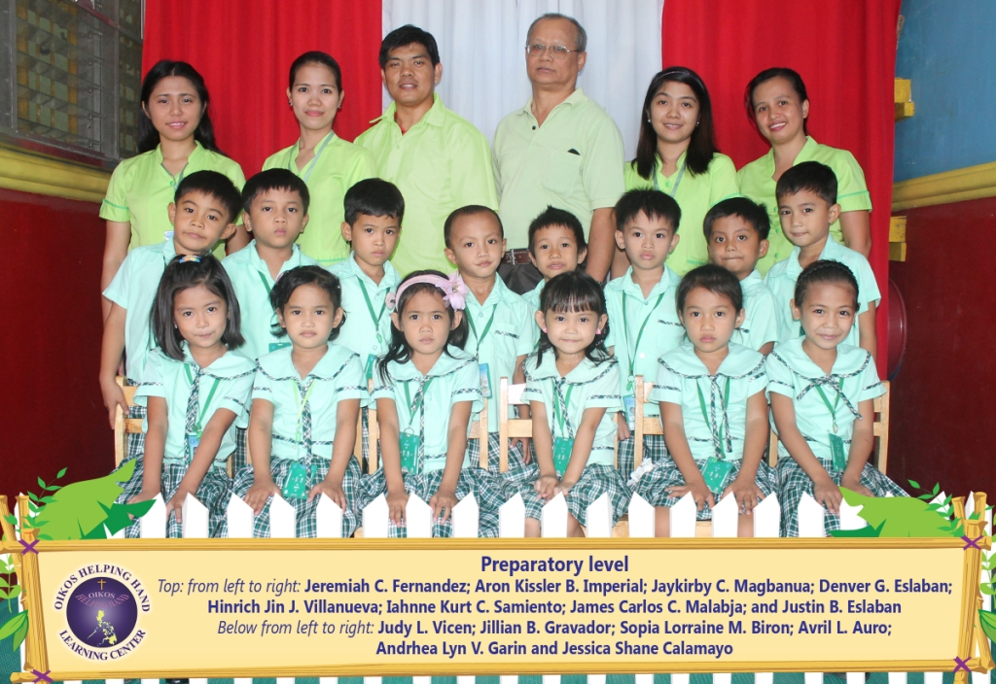
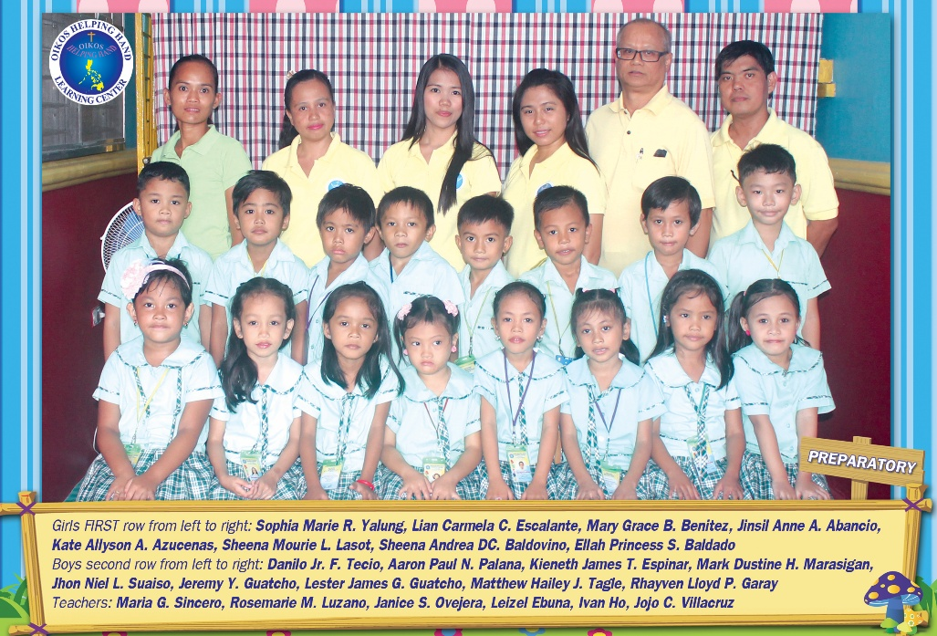
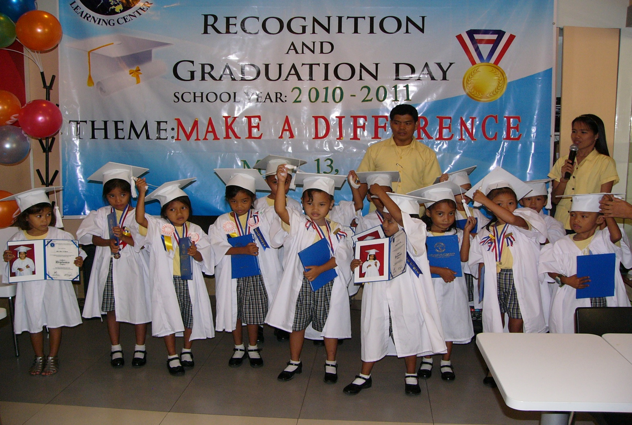
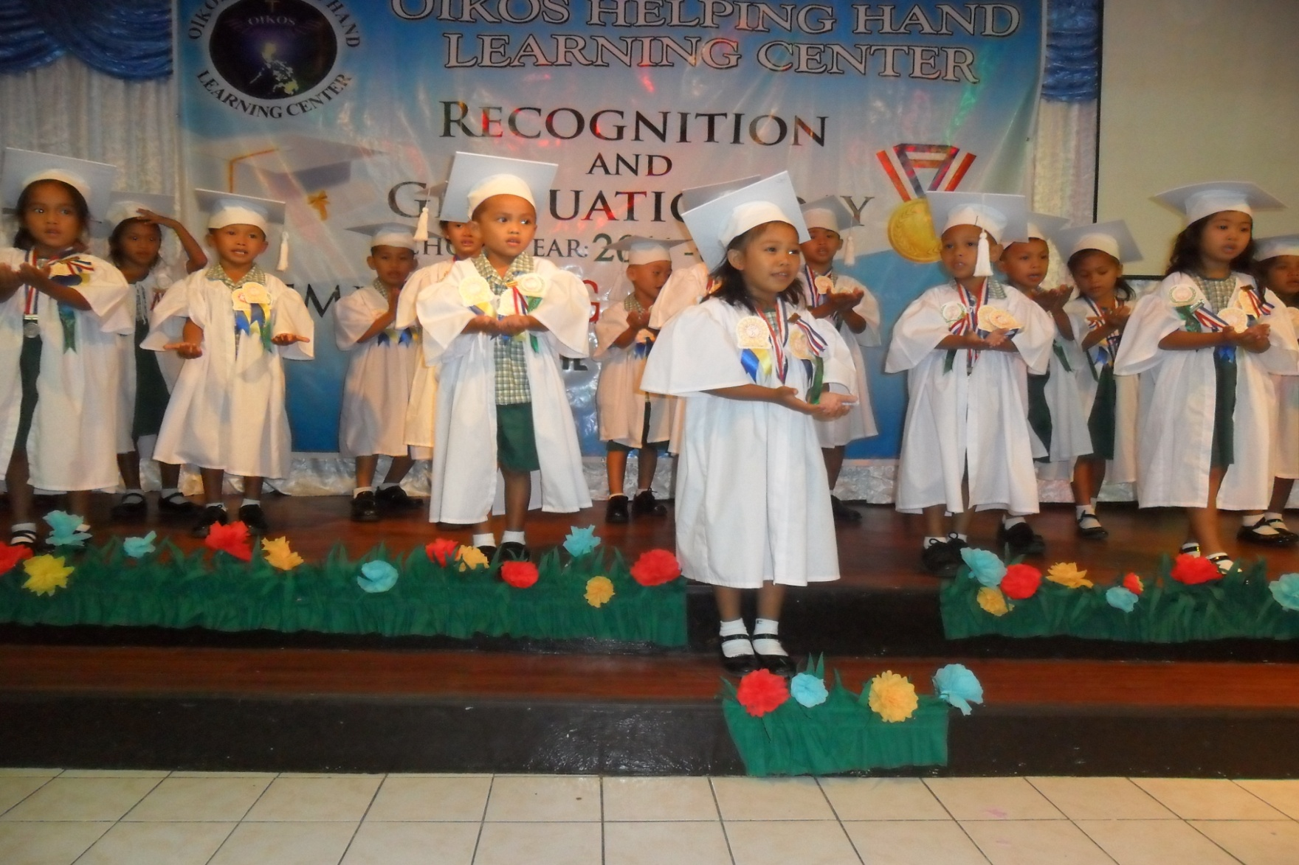
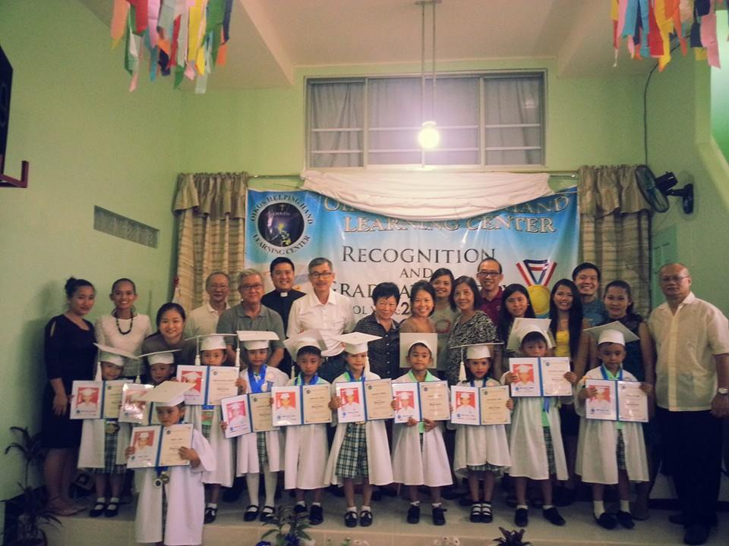
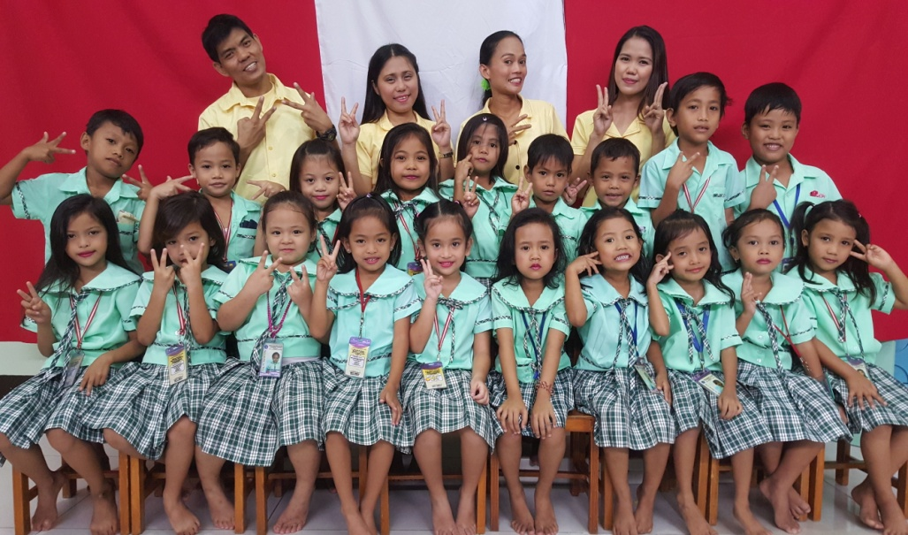
2011 - 2016 Batches who finished their two years in kindergarten.
2013
2014
2012
2011
2016
2015

Slide 14
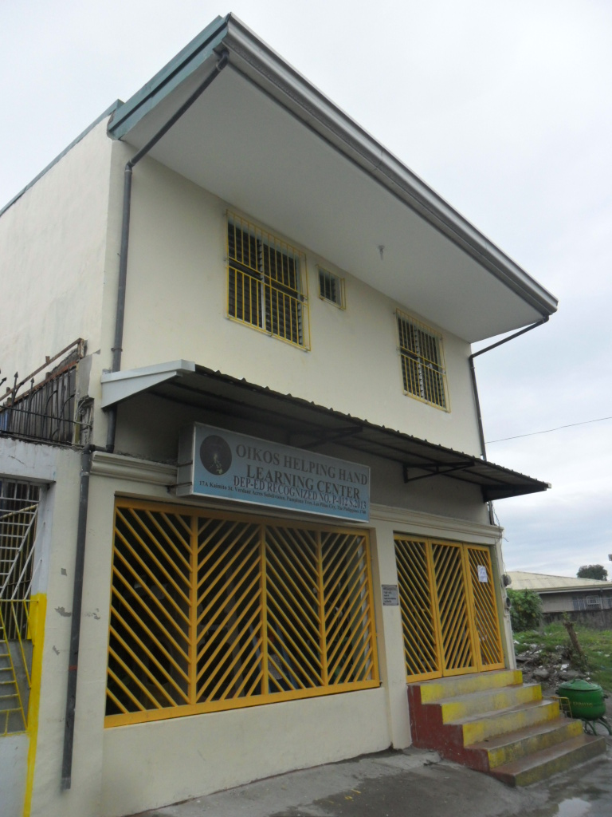
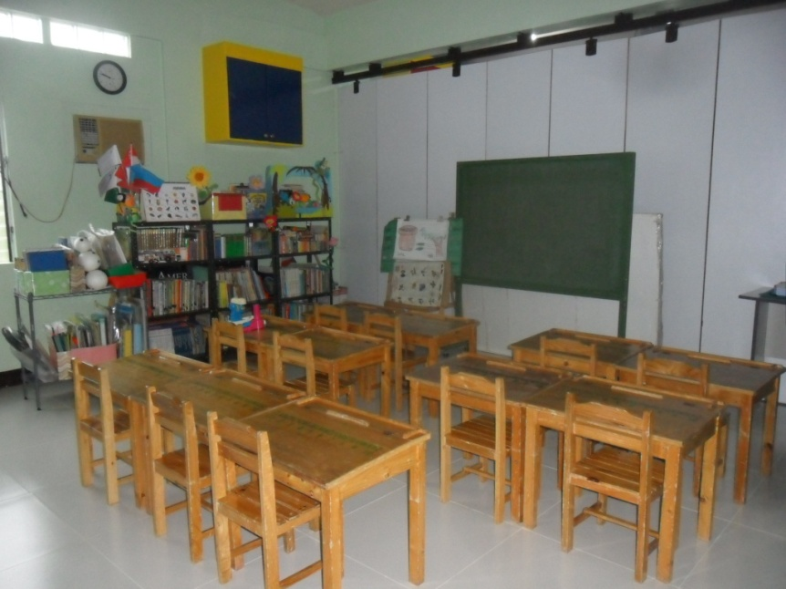
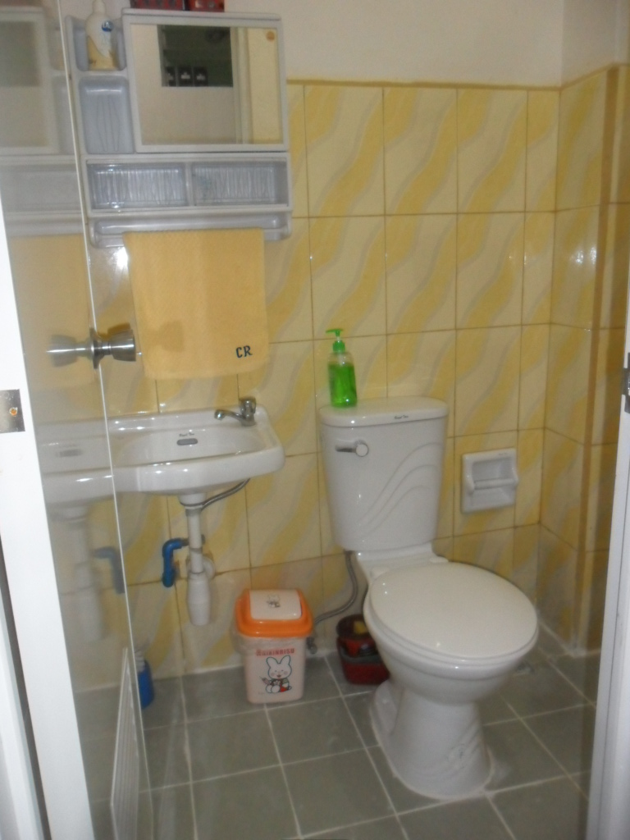
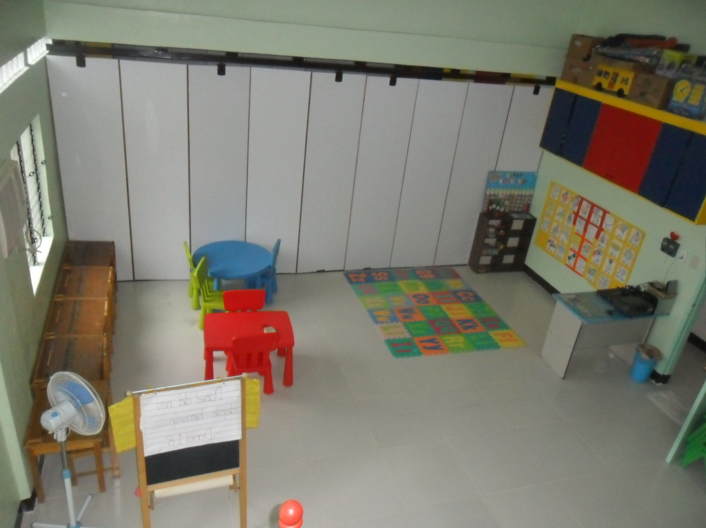
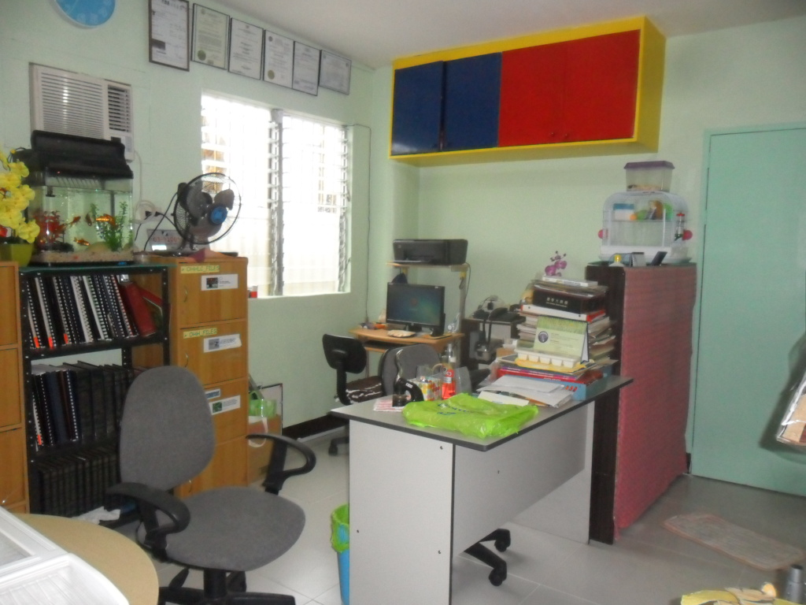
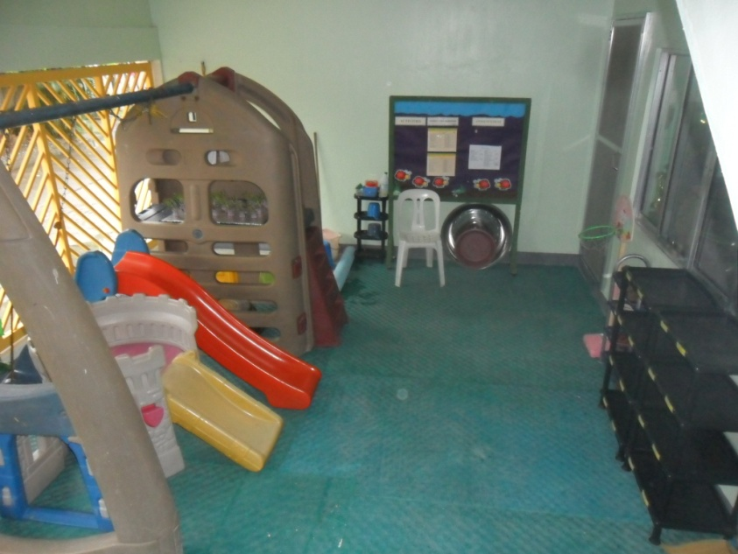
2013 The Department of Education, granted and released the Recognition Certification of O.H.H.L.C
2015
O.H.H.L.C Renovation

Slide 15
Oikos Singapore
GROUP
(SPONSOR)
Oikos Philippines
Headed by:
Ivan and Maureen Ho
Oikos Helping Hand Learning Center
Other
Ministry
Administrator , Teachers and Staff
Scholars

